Slide 1
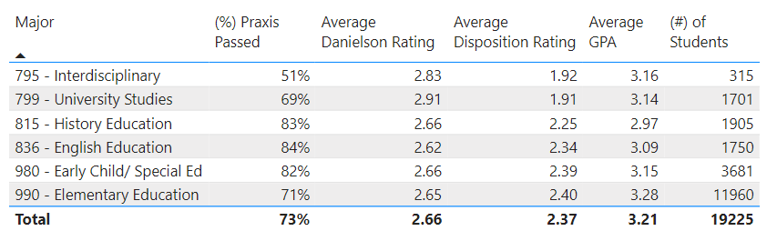
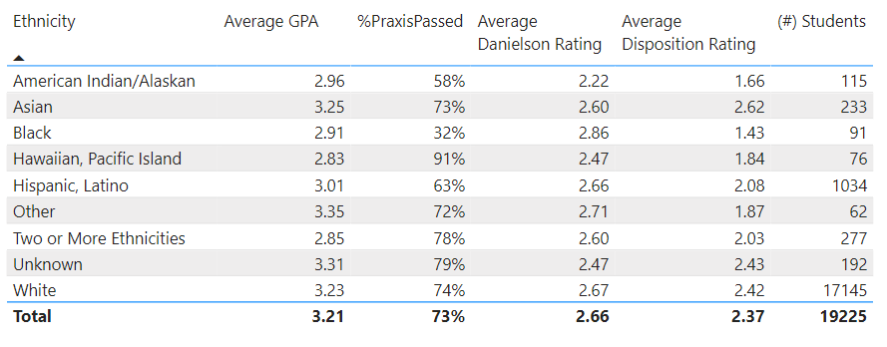
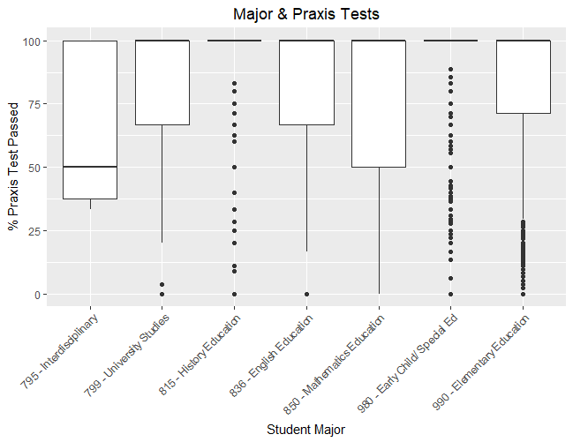
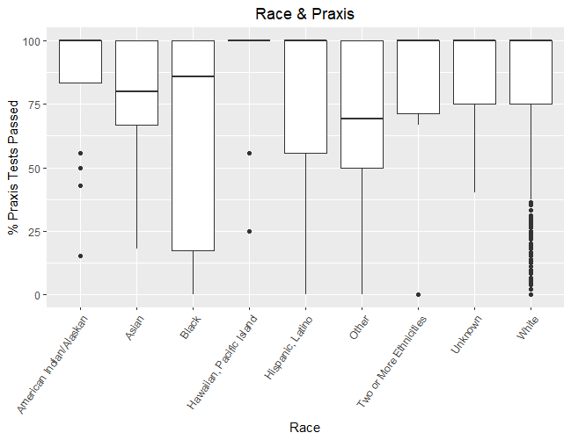
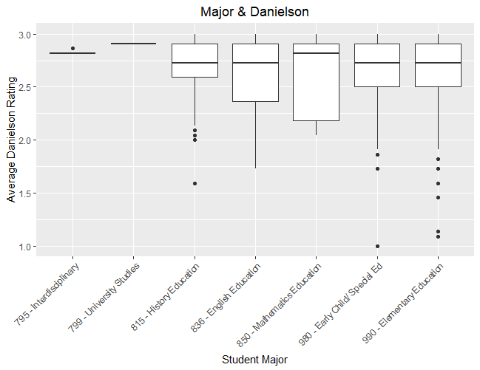
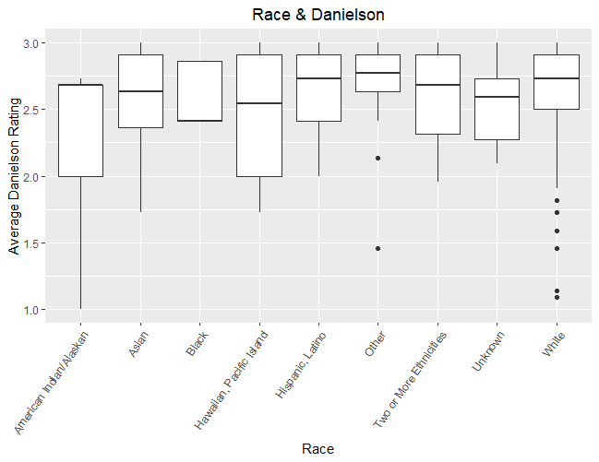
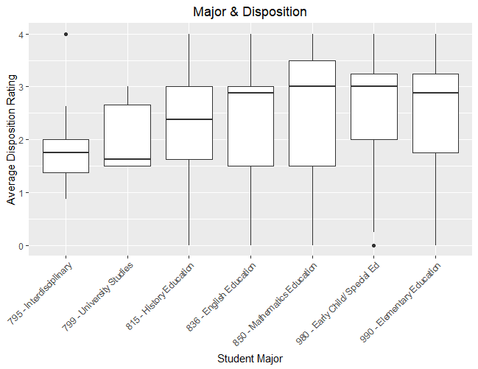
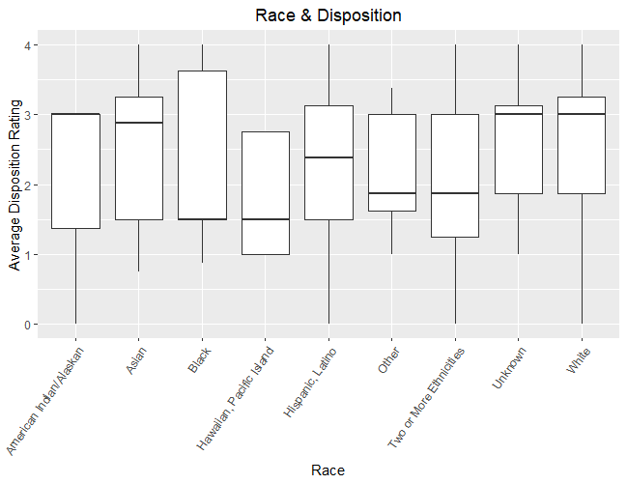
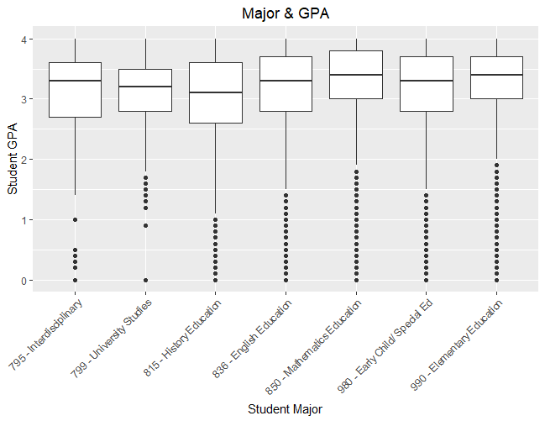
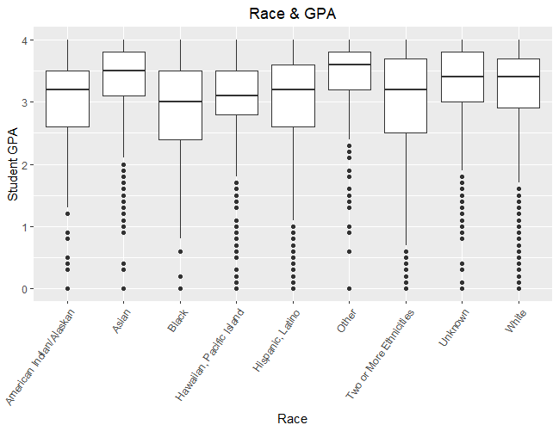
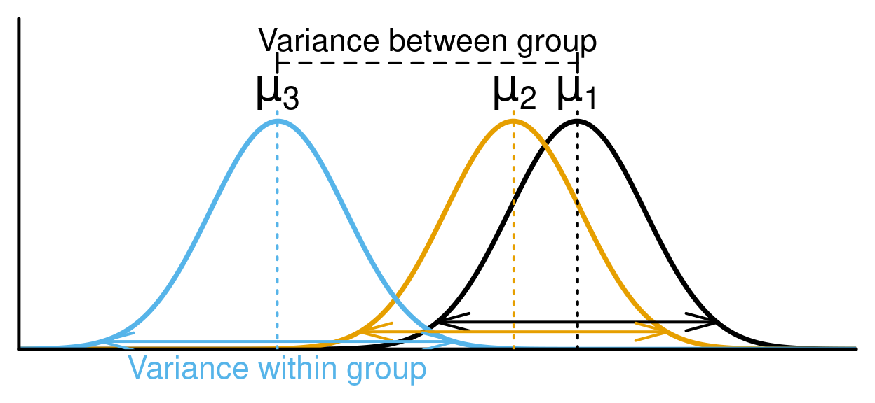

Preliminary Analysis of BYU-Idaho’s Teacher Education Program
For Select Majors
Abstract
Major
Race/Ethnicity
Conclusions
This project will consist of building regression models, explaining results of said models, creating a dashboard for an exploratory analysis and data visualization.
The following visuals show the distribution of the data contained within the tables below. The dataset used consists of students 19225 students who have declared the majors found in the Major table on the left. All visuals are broken down by the major on the left and race/ethnicity on the right.
The results of all the ANOVA models run were all statistically significant. This means that there are statistical differences between Major, Ethnicity, and the response variables tested (percent Praxis passed, Danielson scores Dispositions ratings, and GPA).
Data Summary | Years Data Available | Record Count | Student Records Total
Total Datapoints | 2003-2023 | 324881 | 31106
Praxis Scores | 2012-2023 | 64189 | 4489
FFT (Danielson) Scores | Fall 2022 – Winter 2023 | 2831 | 803
Credentialing Status | 2003-2023 | 7074 | 7045
Major
Praxis: The interdisciplinary studies majors have the lowest median Praxis Pass rates (51%).
Danielson: The university studies major has the highest median Danielson score (2.91).
Disposition: Something interesting is that the university studies major has the lowest Disposition rating (1.91).
GPA: The GPA for each major is also found to be significantly different too, with those in History Education having the lowest median GPA around a GPA of 2.97 where Elementary Ed has the highest of 3.28.
Introduction
The full scope of this project will take more than one semester to realize, thus the results and conclusions herewith are only preliminary.
The subject of this senior project will be academic data provided by BYU-Idaho Institutional Data Analysis Services (IDAS). I will be investigating the performance of the graduates from the education program and see if there is a relationship between performance at school (GPA), on standardized tests for teachers (Praxis), on evaluations by mentors/supervisors (Danielson and Disposition), and in the classroom (State of Idaho Survey).
Ethnicity/Race
Praxis: Most ethnicities have a median Praxis pass rate of 100%, but some are lower
Danielson: The Danielson scores have a relatively good spread across the ethnicities with the highest score being 2.86.
Disposition: The median average disposition rating is 1.43, this is significantly lower than most of the average ratings across ethnicity.
GPA: Just like Danielson and Disposition, GPA also has a sizable spread with the lowest median average GPA being 2.85 and the highest being 3.35.
Definitions
(%) Praxis Passed: A standardized test required for all perspective teachers. We report the percentage of all tests passed.
Average Danielson Rating: An evaluation given to teachers on a scale of 1 to 3. We report the average rating for all categories.
Average Disposition Rating: An evaluation given to teachers on a scale of 0 to 4. We report the average rating for all categories.
Average GPA: Grade point average, on a scale of 0 to 4, reported for all categories.
Objectives
Accomplishments
Create Power BI dashboard to perform exploratory analysis.
Leverage R for statistical analysis, data cleaning, and data visualization.
Apply data analytics skills to provide general consultation.
There are some things that I am proud of when it comes to this project. I started this project later that desired in the semester and was able to finish what was asked of me in a timely fashion. Some of those details can be found on my blog, which details the journey I took to finish this project.
Throughout this project, I was able to find full-time employment within my discipline of study and this project will be very similar to what I will be asked to do at my new job.
This project allowed me to learn new skills in R when it comes to cleaning data and allowed me to use my expertise in data visualization to create the visuals shown here.
I am proud to say that my time at BYUI prepared me to act as a consultant and analyst on this project and successfully prepared me for full-time employment in the data analysis field.
Models
This project used several statistical models to analyze the data and draw conclusions.
Use ANOVA to check to see if there were differences between the percent of Praxis tests passed across various categories namely ethnicity.
Links
Template:
https://www.posternerd.com/sciposters-templates?signs_redirect
Figure 1:
https://r.qcbs.ca/workshop04/book-en/t-test-and-anova.html
Project Blog:
Figure 1
Notes:
Break up conclusions into major/ethnicity sections – cut down the words. Define your variables. Color code for major & race

